Slide 1
A History Institute for Teachers
TEACHING ABOUT ISRAEL AND PALESTINE
Hotel Palomar, 117 S 17th St, Philadelphia, PA 19103
October 25-26, 2014

Slide 2
Palestinian and Israeli Public Opinion on Solutions to the Arab-Israeli Conflict
Justin Finkelstein
October 26, 2014
Presented for the Foreign Policy Research Institute (FPRI) History Institute for Teachers on “Teaching about Israel and Palestine”

Slide 3
Overview
1) The Joint Israeli Palestinian Poll
2) Palestinians
a) Polls that support the findings of Joint Poll
b) Polls that complicate the findings of the Joint Poll
c) Palestinians: Conclusions
3) Israelis
a) Polls that support the findings of the Joint Poll
b) Polls that complicate the findings of the Joint Poll
c) Israelis: Conclusions
4) Conclusions: Israeli and Palestinian Public Opinion

Slide 4
What is meant by “Israeli and Palestinian Public Opinion”?
Representative samples (approximately 500 or more) of both Israelis and Palestinians
Who are Israelis?
About 8.1 to 8.9 million Jews, Muslims, Druze, Christians and others who are Israeli citizens
75% Jewish, 20% Muslim, 5% other
Who are Palestinians?
About 4 to 4.5 million Muslims, Christians and others who live in the West Bank and Gaza Strip
97% Muslim, 3% Christian
Notes:
According to CIA World Factbook, https://www.cia.gov/library/publications/the-world-factbook/

Slide 5
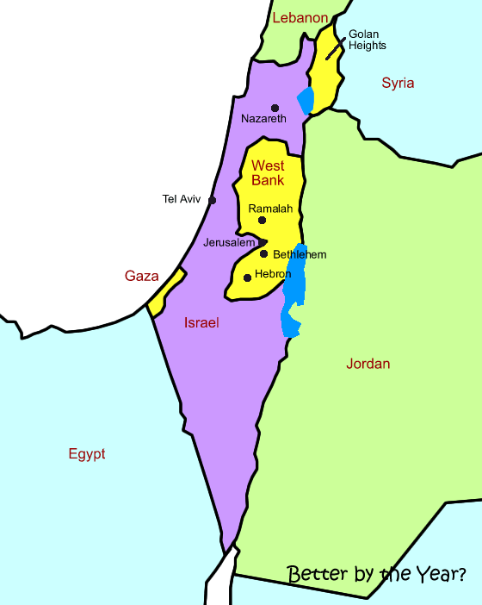

Slide 6
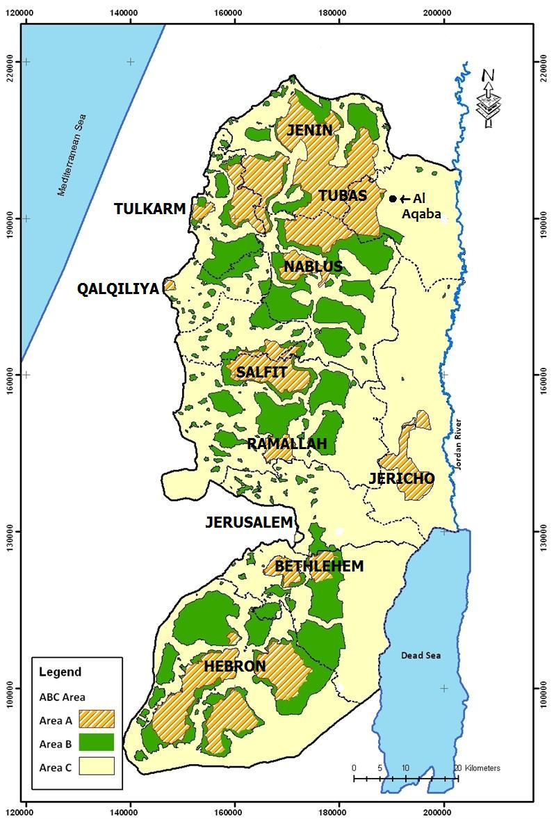

Slide 7
1) The Joint Israeli Palestinian Poll
Conducted jointly by the Harry S. Truman Research Institute for the Advancement of Peace at The Hebrew University of Jerusalem and the Palestinian Center for Policy and Survey Research (PSR) in Ramallah
Comprehensive poll conducted each December/January since 2003
Other joint polls also periodically conducted, and other polls sometimes conducted independently by PSR
Presents six main elements of a two-state solution to the conflict in the spirit of the Clinton Parameters and Geneva Initiative

Slide 8
#1: Borders
The entirety of the West Bank and Gaza Strip would make up Palestine, with exception of 3% of the West Bank, with proportional land swaps to make up for this

Slide 9
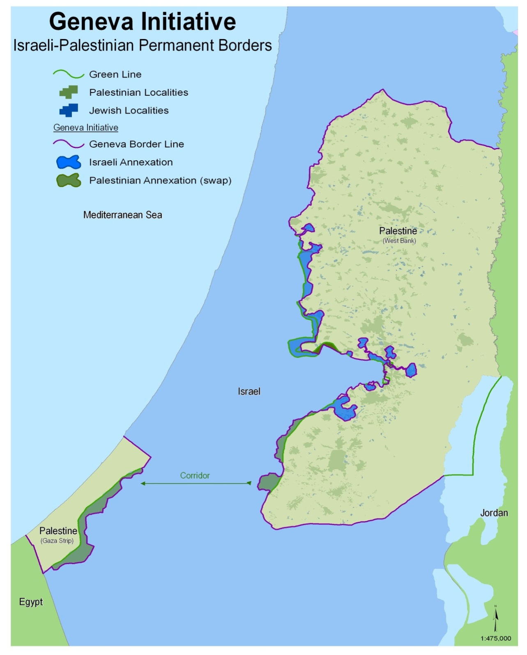

Slide 10
#2: Refugees
Solution based on UN Resolutions 194 and 242. Palestinian refugees to be given 5 options for permanent residency:
Palestinian state
Areas transferred from Israel to Palestine
Current country of residence (subject to that country’s discretion)
A third country (subject to that country’s discretion)
Israel (subject to Israel’s discretion, but Israel “will consider the average number of refugees admitted to third countries”)
All refugees would receive compensation

Slide 11
#3: Jerusalem
East Jerusalem capital of Palestine, with Arab neighborhoods falling under Palestinian sovereignty and Jewish neighborhoods under Israeli sovereignty
All of Old City and Haram al-Sharif (Temple Mount) to Palestine except for Jewish Quarter and Wailing Wall plaza; those areas and West Jerusalem will be capital of Israel

Slide 12
#4: Demilitarized Palestinian State
Palestine would have no army, but a strong security force and multinational forces to ensure its safety and security
Both Israel and Palestine would be committed to ending all violence against each other

Slide 13
#5: Security Arrangements
Palestine to have sovereignty over its land, water and airspace
Israel would have right to use Palestinian airspace for training purposes
Israel would maintain two security stations in the West Bank for 15 years
Multinational force would monitor borders and implementation of agreement by both sides

Slide 14
#6: End of Conflict
Upon full implementation of agreement:
Conflict will be declared over by both sides
Mutual recognition of each state as the homeland of its respective peoples

Slide 15
Review: The 6 Parts of the Joint Polls’ Peace Plan
Borders: The entirety of the West Bank and Gaza Strip would make up Palestine, with exception of 3% of the West Bank with proportional land swaps to make up for this
Refugees: Solution based on UN Resolutions 194 and 242. Palestinian refugees to be given 5 options for permanent residency: a) Palestinian state b) areas transferred from Israel to Palestine c) current country of residence d) a third country e) Israel.
All refugees would receive compensation.
Jerusalem: East Jerusalem capital of Palestine, with Arab neighborhoods falling under Palestinian sovereignty and Jewish neighborhoods under Israeli sovereignty. All of Old City and Haram al-Sharif to Palestine except for Jewish Quarter and Wailing Wall. That and West Jerusalem will be capital of Israel.
Demilitarized Palestinian State: Palestine would have no army, but a strong security force and multinational forces to ensure its safety and security. Both Israel and Palestine would be committed to ending all violence against one another.
Security Arrangements: Palestine to have sovereignty over its land, water and airspace; Israel would have right to use airspace for training purposes; Israel would maintain two security stations in the West Bank for 15 years. Multinational force would monitor borders and implementation of agreement by both sides
End of Conflict: Upon full implementation of agreement, conflict will be declared over by both sides, which would recognize each state as the homeland of its peoples.

Slide 16
Joint Poll Results: 2003-2013
 |  | Dec. ‘03 | Dec. ‘04 | Dec. ‘05 | Dec. ‘06 | Dec. ‘07 | Dec. ‘08 | Dec. ‘09 | Dec. ‘10 | Dec. ‘11 | Dec. ‘12 | Dec. ‘13 | AVG
Overall package | ISR | 47% | 64% | 64% | 52% | 53% | 52% | 46% | 52% | 58% | 56% | 54% | 54.36%
 | PAL | 39% | 54% | 46% | 48% | 47% | 41% | 38% | 40% | 50% | 43% | 46% | 44.73%

Slide 17
Summary Table: 2003-2013 - Breakdown
 |  | Dec 03 | Dec 04 | Dec 05 | Dec 06 | Dec 07 | Dec 08 | Aug 09 | Dec 10 | Dec 11 | Dec 12 | Dec 13
1) Borders and Territorial Exchange | ISR | 47% | 55% | 53% | 44% | 46% | 46% | 47% | 49% | 51% | 46% | 44%
 | PAL | 57% | 63% | 55% | 61% | 56% | 54% | 49% | 49% | 63% | 53% | 52%
2) Refugees | ISR | 35% | 44% | 43% | 38% | 44% | 40% | 36% | 36% | 42% | 42% | 39%
 | PAL | 25% | 46% | 40% | 41% | 39% | 40% | 37% | 41% | 45% | 41% | 46%
3) Jerusalem | ISR | 41% | 39% | 38% | 38% | 36% | 40% | 34% | 38% | 38% | 38% | 37%
 | PAL | 46% | 44% | 33% | 39% | 36% | 36% | 31% | 36% | 40% | 29% | 32%
4) Demilitarized State | ISR | 61% | 68% | 69% | 62% | 61% | 64% | 56% | 62% | 67% | 70% | 60%
 | PAL | 36% | 27% | 20% | 28% | 23% | 27% | 24% | 24% | 32% | 28% | 28%
5) Security Arrangements | ISR | 50% | 61% | 62% | 51% | 53% | 56% | 49% | 52% | 63% | 59% | 52%
 | PAL | 23% | 53% | 43% | 42% | 51% | 35% | 34% | 38% | 50% | 46% | 52%
6) End of Conflict | ISR | 66% | 76% | 80% | 68% | 66% | 67% | 68% | 68% | 70% | 68% | 66%
 | PAL | 42% | 69% | 64% | 62% | 66% | 55% | 55% | 58% | 63% | 59% | 63%
Notes:
Green denotes what is among the most popular points of the plan among both Israelis and Palestinians and red denotes what is least popular

Slide 18
Latest Polls from PSR and The Hebrew University

Slide 19
Arab Peace Initiative, 2002
“Arab recognition of and normalization of relations with Israel after it ends its occupation of Arab territories occupied in 1967 (2013: with minor swaps) and after the establishment of a Palestinian state.
Israeli retreat from all territories occupied in 1967 including Gaza, the West Bank, Jerusalem and the Golan Heights, and the establishment of a Palestinian state.
Refugee problem will be resolved through negotiations in a just and agreed upon manner and in accordance with UN resolution 194.
In return, all Arab states will recognize Israel and its right to secure borders, will sign peace treaties with Israel and establish normal diplomatic relations.”
Notes:
http://www.pcpsr.org/survey/polls/2014/p52ejoint.html

Slide 20
API: Support over past several years
Israelis: 20%-35%
Joint poll conducted June 8-15, 2014: 29% support, 64% oppose
Palestinians: 47%-65%
Joint poll conducted June 5-7, 2014: 50% support, 46% oppose
Notes:
http://www.pcpsr.org/survey/polls/2014/p52ejoint.html

Slide 21
Joint Poll: What about a One-state Solution, in Which “Arabs and Jews Enjoy Equality?”
Palestinians: Approximately 25% to 30% support
Latest poll of Palestinians from September 2014 found 26.7% support and 71% oppose a one-state solution
Israelis: Approximately 25% to 32% support
Latest poll of Israelis from June 2013 poll surveyed 32% in support of one-state solution
Notes:
http://www.pcpsr.org/survey/polls/2013/p48ejoint.html

Slide 22
What Do Other Polls Say?

Slide 23
2) Palestinians:
Polls that Corroborate the Findings of PSR/Joint Polls

Slide 24
Palestinian-run Jerusalem Media and Communications Center (JMCC) poll from April 2014 (has not conducted poll since):
Some believe that a two-state formula is the favored solution for the Arab-Israeli conflict, while others believe that historic Palestine cannot be divided and thus the favored solution is a bi-national state on all of Palestine where Palestinians and Israelis enjoy equal representation and rights. Which of these solutions do you prefer?
 | Total (1200) | West Bank (750) | Gaza (450)
Two-state solution: a Palestinian and an Israeli state | 48.7% | 45.2% | 54.4%
Binational state on all historic Palestine | 18.8% | 23.9% | 10.2%
Palestinian State* | 15.3% | 13.9% | 17.8%
Islamic State* | 1.0% | 1.2% | 0.7%
Others | 1.6% | 0.8% | 2.9%
No Solution | 11.8% | 11.9% | 11.8%
I don’t know/no answer | 2.8% | 3.1% | 2.2%
*These answers were not included as part of the options read to interviewees
Notes:
http://jmcc.org/documents/81_April_2014_english_with_Charts.pdf

Slide 25
Ramallah-based Arab World for Research and Development (AWRAD) poll, May 2014 (most recent that deals with two-state solution)
 | West Bank | Gaza | Total
Do you support the principle of a two-state solution with a Palestinian state living side-by-side in peace with Israel?
Support | 57.5% | 52.0% | 55.4%
Oppose | 38.8% | 46.9% | 41.8%
Don’t know | 3.7% | 1.1% | 2.8%
Notes:
Mostly consistent with findings of AWRAD since polling started in 2007 (never below 45% support for a two-state solution)

Slide 26
Al-Najah University Poll, Sept. 11-13, 2014
Do you support the two-state solution provided that a Palestinian state is created to live side by side with Israel?
 | Total | West Bank | Gaza Strip
I strongly support | 14.6% | 11.7% | 19.6%
I support | 41.8% | 46.0% | 34.6%
I reject | 23.9% | 27.1% | 18.4%
I strongly reject | 14.9% | 13.4% | 17.6%
No opinion/I do not know | 4.7% | 1.7% | 9.8%
Total | 100.0% | 100.0% | 100.0%

Slide 27
Same Al-Najah Poll Sept. 11-13, 2014:
Do you support or reject a one-state solution in which Palestinians and Israelis enjoy equal rights?
 | Total | West Bank | Gaza Strip
I strongly support | 7.5% | 4.3% | 13.0%
I support | 18.8% | 18.1% | 20.0%
I reject | 42.1% | 50.2% | 28.0%
I strongly reject | 26.2% | 25.5% | 27.4%
No opinion/I do not know | 5.4% | 1.9% | 11.6%
Total | 100.0% | 100.0% | 100.0%

Slide 28
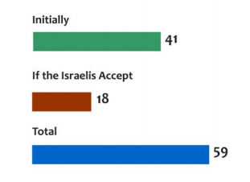
Poll Commissioned by the Brookings Institution November 2013
Presented almost the same peace agreement as in Joint Poll, with notable exception that “Palestinians would recognize Israel as a state of the Jewish people and of all its citizens.”
Conducted by Palestinian Center for Public Opinion (PCPO)
Only 30% positively viewed one state scenario in which Israelis and Palestinians live in equality

Slide 29
Palestinians:
Polls that Complicate the Findings of PSR

Slide 30
Washington Institute for Near East Policy (WINEP) poll, June 15-17, 2014
Please state your view about the main Palestinian national goal for the next five years | Total | West Bank | Gaza Strip
The goal should be to work toward reclaiming all of historic Palestine from the river to the sea | 60.3% | 55.4% | 68.4%
The goal should be to end the occupation of the West Bank and Gaza to achieve a two-state solution | 27.3% | 30.6% | 21.8%
The goal should be to work for a one-state solution in all of the land: a state in which Arabs and Jews will have equal rights in one country, from the river to the sea | 10.1% | 11.2% | 8.2%
No opinion/don’t know | 2.3% | 2.8% | 1.6%
Notes:
http://www.washingtoninstitute.org/uploads/Documents/other/PalestinianPollingReport_June2014.pdf

Slide 31
The Israel Project (TIP)/Greenberg Quinlan Rosner/PCPO poll, 2011

Slide 32
Majority of Palestinians Favor One Palestinian State over the Entire Land:

Slide 33
But Majority also Supported Obama’s Framework for a Two-State Solution
“U.S. President Barack Obama recently announced principles that should be a foundation for any peace negotiations between Israel and the Palestinians. He said the border between Israel and Palestine should be based on the 1967 lines with mutually-agreed swaps of land to take account of realities on the ground so both sides can achieve a secure and just peace. Would you favor or oppose a two-state solution with these borders?”

Slide 34
August 2010 AWRAD Poll

Slide 35
PSR Post-Gaza War Poll, Aug. 26-30
In elections, Ismail Haniyeh would defeat Mahmoud Abbas, 61% to 32%
46% would vote for Hamas, 31% for Fatah
“72% favors the transfer of Hamas’ armed approach to the West Bank”

Slide 36
Voting: Abbas vs. Haniyeh

Slide 37
Voting: Fatah vs. Hamas

Slide 38
Palestinian Public Opinion: Conclusions
Theory: There is a difference between what one wants and what one is willing to accept
2 types of questions:
What do you want?
Do you agree with/support…?
Palestinians want one Palestinian state over the entire land and would like to work toward that goal, yet they are also agreeable to a two-state solution – even one that would leave Israel with a strong Jewish majority

Slide 39
3) Israelis:
Polls that Corroborate the Findings of The Hebrew University

Slide 40
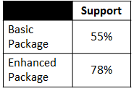
Washington D.C.-based S. Daniel Abraham Center for Middle East Peace: Polls of Israelis commissioned 2003 to 2012

Slide 41
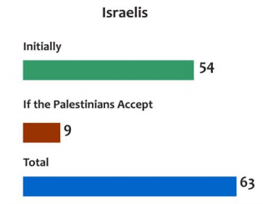
Poll Commissioned by the Brookings Institution, November 2013
Midgam Project (Israeli firm) conducted
Only 21% positively viewed one state scenario in which Israelis and Palestinians live in equality
Notes:
http://www.brookings.edu/~/media/events/2013/12/06%20public%20opinion%20israel%20palestine/israel%20palestine%20opinion%20poll%202.pdf

Slide 42
Tel Aviv-based Institute for National Security Studies (INSS) poll, January 2014
Found about half of Israeli public in favor of a two-state solution similar to (slightly less far-reaching) the Clinton Parameters/Geneva Initiative:
Support | 51%
Oppose | 24%
Indecisive | 25%
Notes:
http://d26e8pvoto2x3r.cloudfront.net/uploadImages/systemFiles/Bagno-Moldavsky%20and%20Ben%20Meir_adkan17_1ENG5.pdf

Slide 43
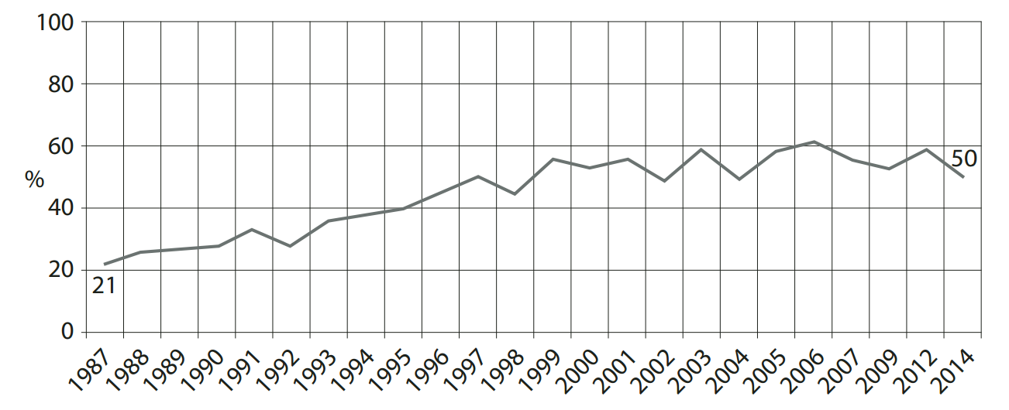
INSS: Israeli Support for Establishment of Palestinian State in the Context of a Permanent Peace Agreement

Slide 44
Geneva Initiative-commissioned Poll Conducted by New Wave Research, mid-September 2014
Poll presented the Geneva Initiative two-state peace plan

Slide 45
Israeli Dialog Poll June 9-11, 2014
“If the prime minister were to reach an agreement that included the establishment of a Palestinian state alongside Israel, would you support a peace agreement?”

Slide 46
Israelis:
Polls That Complicate the Findings of The Hebrew University

Slide 47
Israeli Dialog Poll June 9-11, 2014
“If the [peace] agreement meant that most of the settlers would be annexed to Israel, Jerusalem would be divided, the refugees would not return to Israel and there would be strict security arrangements, would you support such an agreement?”
Support | 35%
Oppose | 58%
Don’t know | 7%
Notes:
http://www.haaretz.com/news/diplomacy-defense/israel-peace-conference/1.601996

Slide 48
Same Poll, Again:
Of the following possibilities, which solution is best for Israel in the long run?
1) One state between the Jordan River and the Sea in which all citizens have equal rights, including the right to vote for the Knesset (Israeli parliament) | 10%
2) Don’t know | 14%
3) One state between the Jordan River and the sea, but with limited rights for Palestinians | 23%
4) Continuation of the present situation | 25%
5) A peace agreement that includes a partition of the land, a partition of Jerusalem, removal of settlements, and no return of refugees to Israel | 28%

Slide 49
Israel Democracy Institute (IDI) Poll July 2013
If Israel and the Palestinians reach an understanding and a permanent peace agreement that includes security arrangements for Israel, a demilitarized Palestinian state, international guarantees, and declaration of the end of the conflict by the Palestinians, in return for this peace agreement, would you support or not support each of the following?
Proposal | % Support
1) Withdrawal to the 1967 lines with territorial swaps | 38.4%
2) Transfer of Arab neighborhoods of Jerusalem to the Palestinian Authority and a special arrangement for the holy places | 43.9%
3) An evacuation of settlements except for Ariel, Maaleh Adumim, and the settlement blocs | 44.3%
4) Israeli recognition in principle of the right of return, permitting the return of a small number of Palestinian refugees and financial compensation for others | 28.4%

Slide 50
Poll conducted by Geocartography Institute (Israel), January 2013
Do you support or oppose the concept that the establishment of two states is the solution to the conflict with the Palestinians? Support: 40%
Oppose: 45%
No reply: 14%

Slide 51
The Jerusalem Center for Public Affairs (JCPA) poll October 12-14, 2014

Slide 52
Israelis: Conclusions
Similar to Palestinians: What do you want vs. what do you accept
Consistency
Prime Minister Netanyahu’s support is crucial
Results can change based on what may seem like small differences
Example: Joint Poll included a joint Israeli and Palestinian declaration that the conflict is over and demilitarized Palestinian state, while Dialog poll did not
JCPA poll did not include as part of peace agreement with Palestinians, and did not include 1967 lines with land swaps
IDI poll: Overall support for entire package vs. support for various components of a plan

Slide 53
4) Israeli and Palestinian Public Opinion: Conclusion
What Israelis and Palestinians want is far apart
But an area of consensus can be found
A two-state solution must include specific components to achieve this consensus on both sides
Among all people living between the Jordan River and the Mediterranean Sea, there is more acceptance of some sort of a two-state solution than there is for any other solution

