Slide 1
Post-Colonial States and the Struggle for Identity in the Middle East since World War Two
Samuel Helfont
Foreign Policy Research Institute, History Institute for Teachers:
Understanding the Modern Middle East:
History, Identity, and Politics

Slide 2
Overview
What does it mean to be post-colonial?
Identity, ideology, and the social fabric of the Middle East
Case 1: Egypt
Case 2: Iraq
Case 3: Iran
Conclusion

Slide 3
What does it mean to be post-colonial?
Three ways to think about being post-colonial:
  Temporal
  Nature of state/politics
  Relationship with modernity

Slide 4
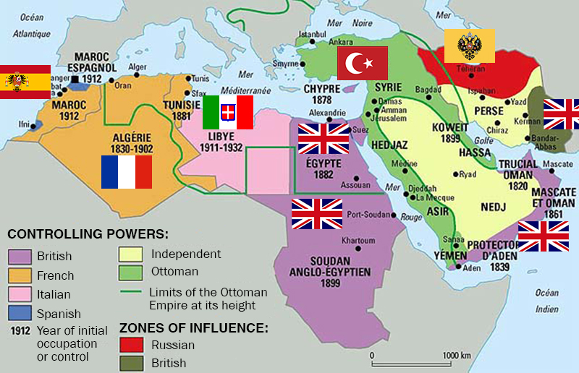
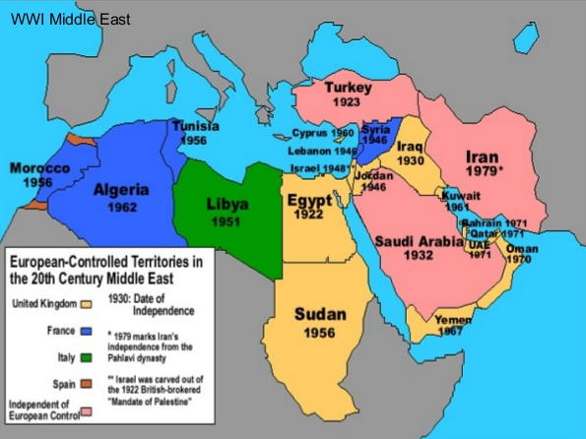
Temporal definition
Empires in the Middle East, 1914
Withdrawal of Empires from Middle East

Slide 5
Nature of states and politics
Continuing the colonial legacy while also rebelling against it
  Non-democratic
  Weak states
  Resort to Violence
  Susceptible to coups

Slide 6
Coups d’États and Revolutions in Post-Colonial Middle East and North Africa
1936 – Iraq
1941 – Iraq
1949 – Syria
1952 – Egypt
1953 – Iran
1958 – Iraq
1960 – Turkey
1962 – Yemen
1963 – Iraq
1963 – Syria
1965 – Algeria
1966 – Syria
1968 – Iraq
1969 – Libya
1970 – Syria
1970 – Oman
1971 – Turkey
1979 – Iran
1980 – Turkey
1987 – Tunisia
1992 – Algeria
1997 – Turkey
2010-Present – Arab Spring
and its aftermath

Slide 7
Post-colonialism or Authoritarianism?
Is a post-colonial regime different from a non-democratic state?
Non-post-colonial counter example: USSR
Post-colonial counter examples: Costa Rica, Israel, Ireland, US

Slide 8


As a critique of modernity
Modernity as Western rather than Universal
Capitalism
Liberalism
Secularism
  “Give to Caesar what is Caesar's,
  and to God what is God's.”
Knowledge, Power, Imperialism

Slide 9
Do post-colonial critiques of modernity differ from similar critiques in the West
Liberalism and its critics
The history of liberalism in the West
Secularism in Western history

Slide 10
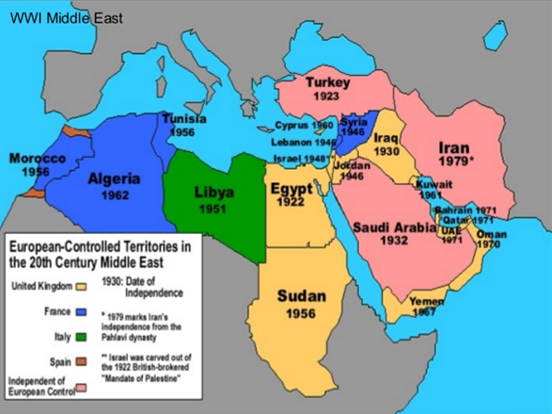
Identity and Imperialism
Why be independent? And is independence enough?
Sources of political identity:
  Ethnic nationalism, Territorial nationalism, Religion
  Authentic indigenous identity vs colonialism
  Inconvenient diversity

Slide 11
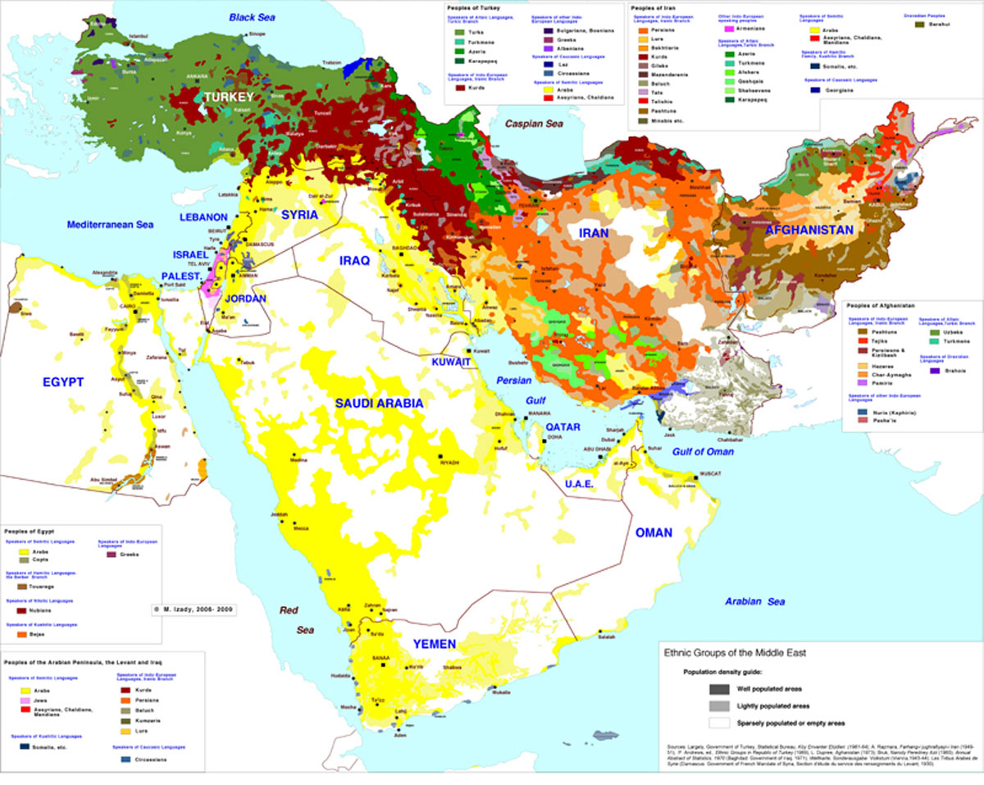
Ethnic Fabric of Middle East

Slide 12
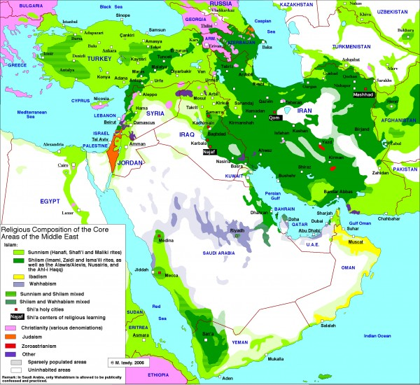
Religious Fabric of Middle East

Slide 13
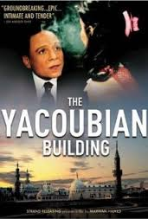
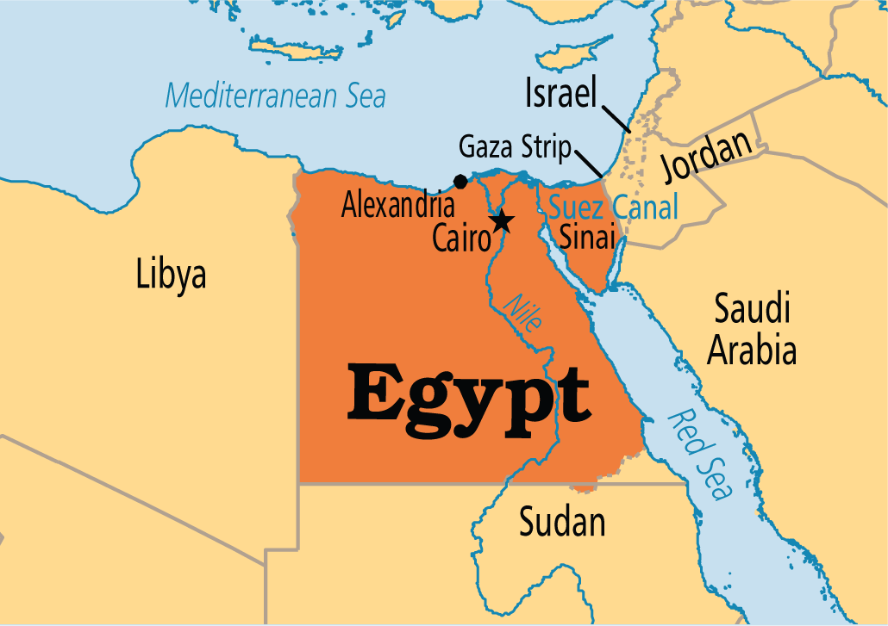
Case 1: Egypt from cosmopolitan to Arab
Egypt as a cosmopolitan center at the turn of the 20th century
“Mutamassirun”

Slide 14
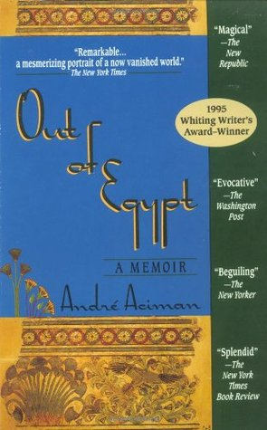
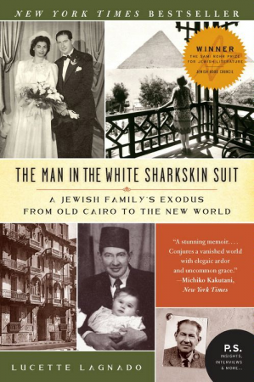
Case 1: Egypt
Andre Aciman describes his uncle as a “Turko-Italian-Anglophile-gentrified-fascist Jew who started his professional life peddling Turkish fezzes in Berlin and Vienna and was to end up the sole auctioneer of deposed King Farouk’s property.”
Lucette Lagnado on her father: “He began each day praying with fellow Jews. He did business with French Colonial merchants and Greek entrepreneurs. He gambled with wealthy Egyptians, including, on occasion, the king. [And he] socialized with British officers stationed in Cairo.”

Slide 15
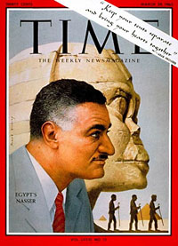
Case 1: Egypt
1922 - Egypt gains independence under King Fuad I; British influence remains significant until mid-1950s
1930s, 40s, 50s – Anti-colonial struggle continues
1952 - Coup transforms Egypt into a republic
Arabization of Egypt under Nasser
Problem of foreign citizenship
1956–57 - Suez crisis and exodus of “mutamassirun”

Slide 16
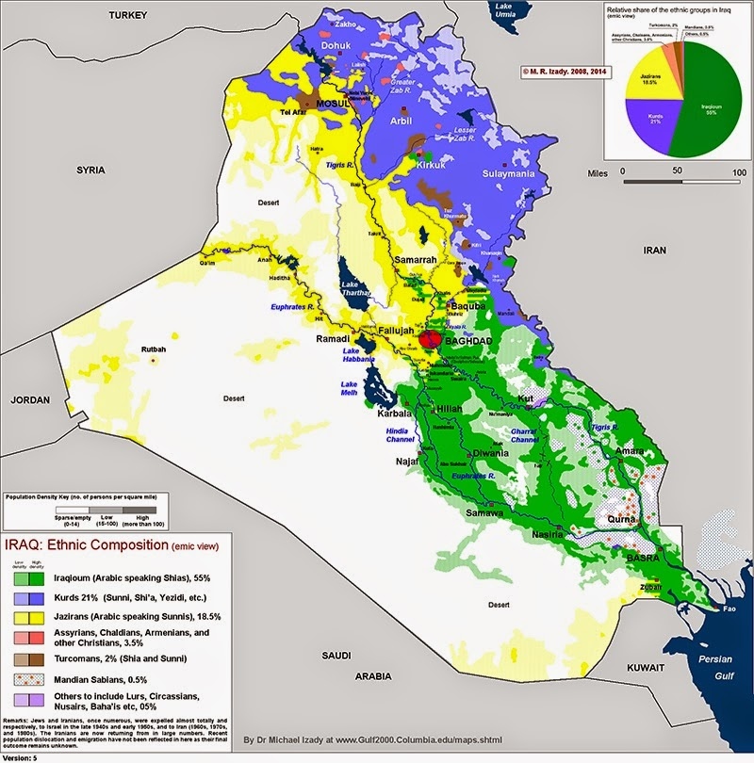
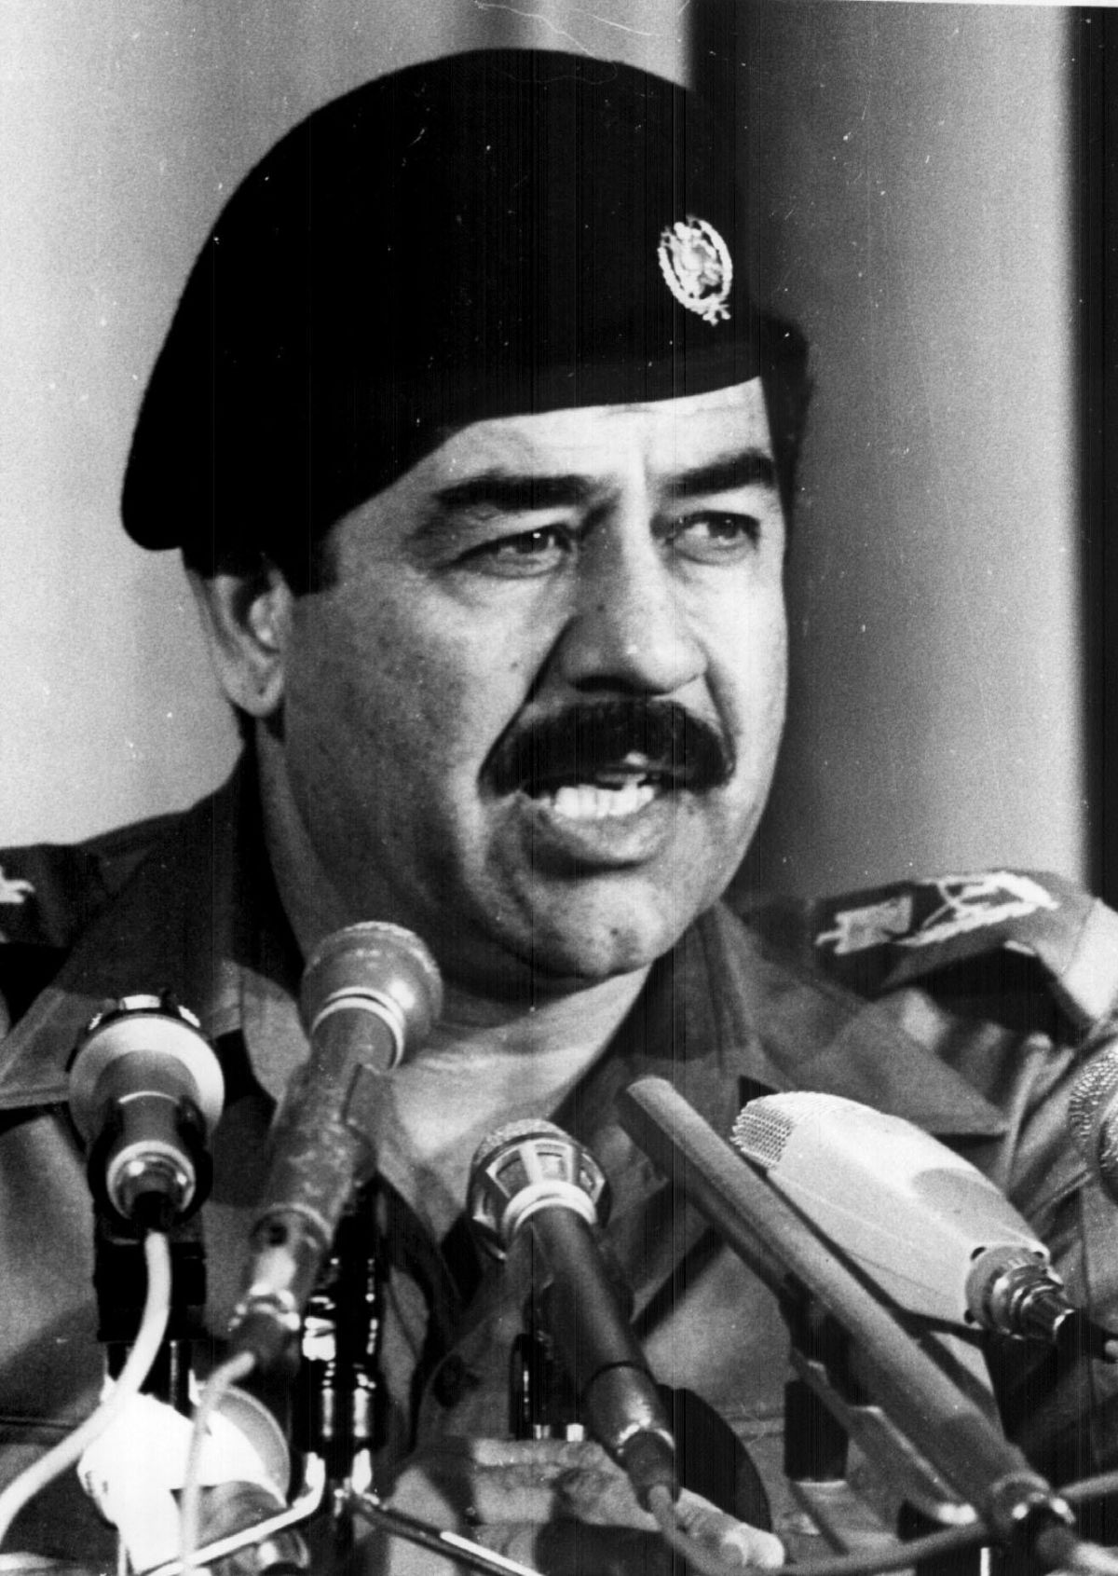
Case 1: Iraq
1932 – Iraq gains independence under King Faisal; British influence remains significant until mid-1950s
1933 – Massacre of Assyrians
1941 – Anti-Jewish pogrom
1951 – Jewish community flees
1958 - Coup transforms Iraq into a republic
1963 – First Ba‘thist coup
1968 – Second Ba‘thist coup
1979 – Saddam becomes president
1988 – Gassing of Kurds

Slide 17
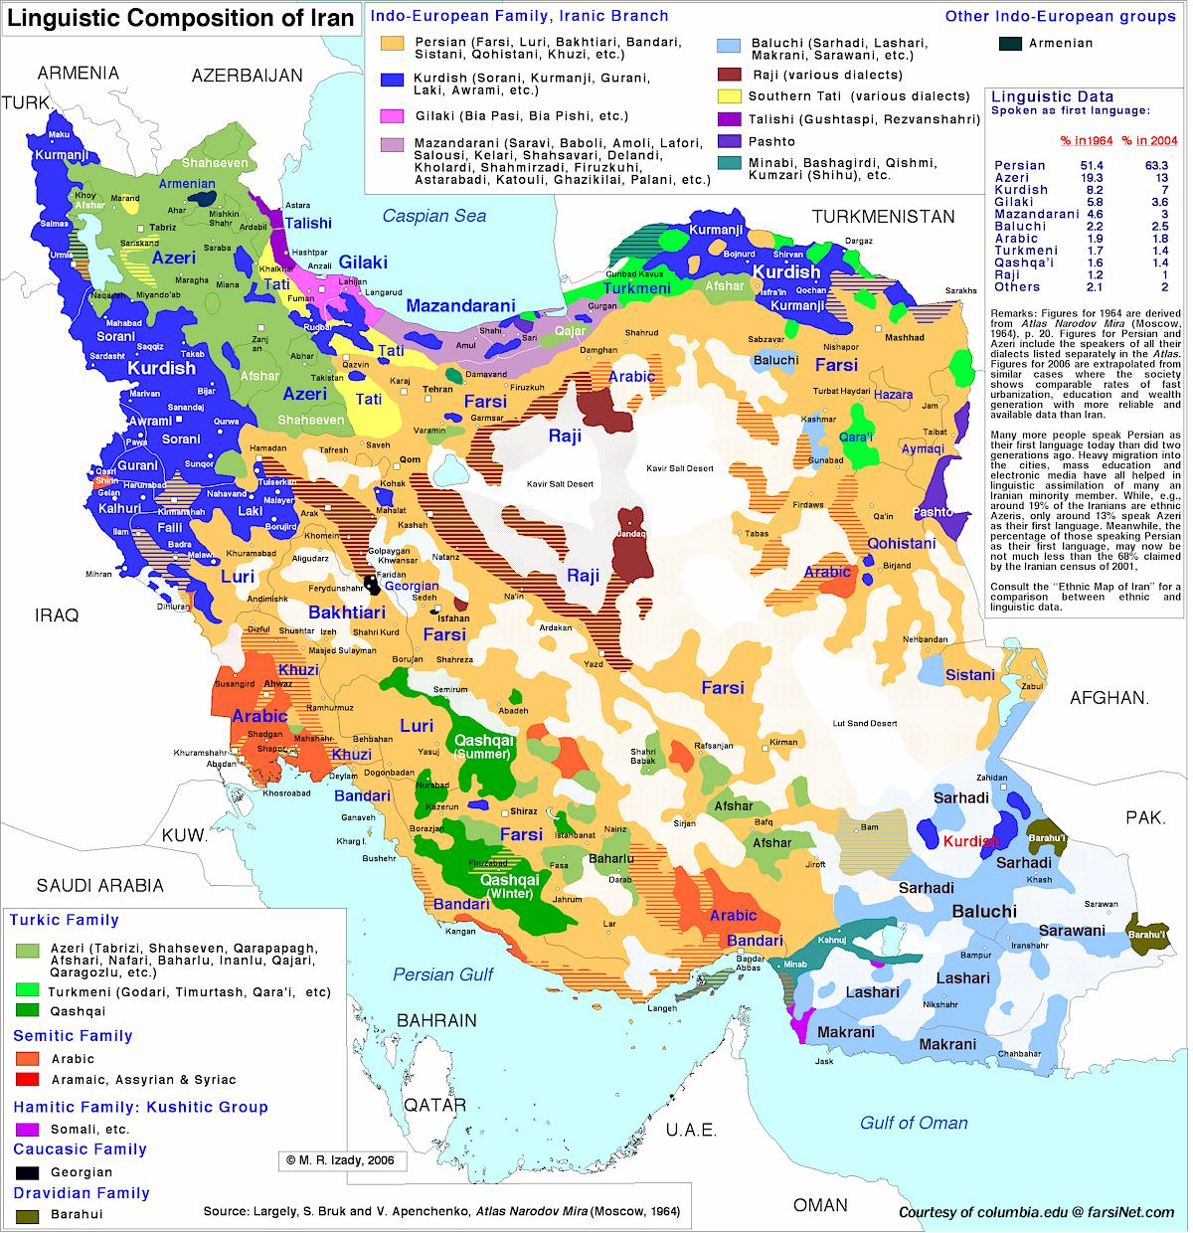
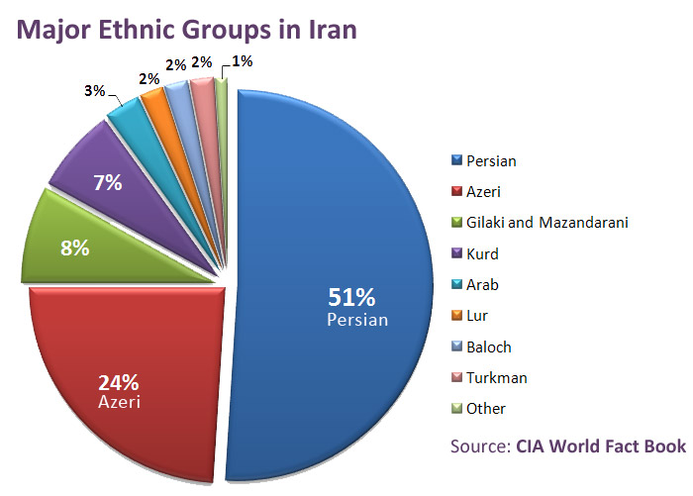
Case 3: Revolutionary Iran?
Is the Islamic Republic of Iran Post-Colonial?
  1953 – Pro-monarch coup supported by the US and the UK
  1979 – Islamic Revolution; Khomeini takes power
  1979-83 – Purges

Slide 18
How useful is the term post-colonialism?

Slide 19
Questions?

